Slide 1
Collaborating with the Public Sector
BUSINESS & STRATEGY | DAVID CALCULLI | 8 FEBRUARY 2013

Slide 2
WHOIS
Developed Drupal sites for design agency, including an iPhone app
Integrated CiviCRM with Drupal, OpenLDAP and Zend Framework
Create ECM-based solutions for large enterprise organisations.
Work exclusively with the Public Sector
2

Slide 3
A typical cross-section
MINISTER
SECRETARY
EXECUTIVES
Department of Government
PUBLIC SERVANTS
SUPPLY CHAIN
3

Slide 4
The Minister
MINISTER
Elected by the Public
Administers a Portfolio
Promotes Outcomes
SECRETARY
EXECUTIVES
PUBLIC SERVANTS
SUPPLY CHAIN
4

Slide 5
The Secretary
MINISTER
Appointed for a fixed term
Reports to the Minister
Delivers Outcomes
SECRETARY
EXECUTIVES
PUBLIC SERVANTS
SUPPLY CHAIN
5

Slide 6
The Executives
MINISTER
Manage daily operations
Create budgets and resources
Deliver Outputs
SECRETARY
EXECUTIVES
PUBLIC SERVANTS
SUPPLY CHAIN
6

Slide 7
The Public Servants
MINISTER
Perform daily operations
Consume budgeted resources
Work towards an Output
SECRETARY
EXECUTIVES
PUBLIC SERVANTS
SUPPLY CHAIN
7

Slide 8
The Supply Chain
MINISTER
Private Suppliers of G&S
Other Public Organisations
Vendors
SECRETARY
EXECUTIVES
PUBLIC SERVANTS
SUPPLY CHAIN
8

Slide 9
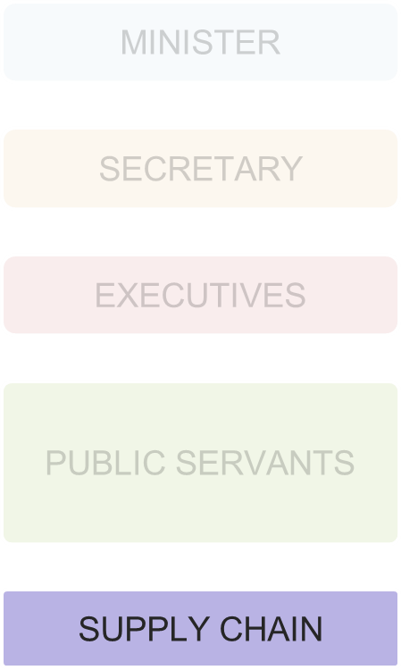
Thinking of levels
MINISTER
Political Level
SECRETARY
EXECUTIVES
Executive Level
PUBLIC SERVANTS
Operational Level
SUPPLY CHAIN
9

Slide 10
Thinking of levels
MINISTER
Political Level
SECRETARY
EXECUTIVES
Executive Level
PUBLIC SERVANTS
Operational Level
SUPPLY CHAIN
10

Slide 11
Thinking of levels
Political Level
Outcomes
Executive Level
Executive Level
Operational Level
Outputs
11

Slide 12
When Outcomes don’t match Outputs
The best place to find efficiency gains
The best place to solve a headache
The best place to realise your value proposition
12

Slide 13
Enterprise Architecture
Business meets IT
The Business has requirements; IT has requirements
Business wants to deliver an innovative outcomes
13

Slide 14
Enterprise Architecture
The Roadmap – it’s your friend
TOGAF, MIKE2.0, Dragon1 EA
Assist CIOs Provide plans easy to integrate into roadmaps
14

Slide 15
TOGAF definition of Enterprise Architecture
“The purpose of enterprise architecture is to optimize across the enterprise the often fragmented legacy of processes (both manual and automated) into an integrated environment that is responsive to change and supportive of the delivery of the business strategy.”
- TOGAF v9 Framework
15

Slide 16
The Big Four ‘Innovative’ Outcomes
Social
Mobile
Big Data
Cloud and XaaS
16

Slide 17
Open Source
Open as in ‘accessible’
Open Government
Proactive Disclosure
Corporate Information
A data system
‘Single source of Truth’
Intellectual Property
17

Slide 18
Open Source
‘Open Source’ is a technical term
Educate your buyer before talking technology
Empower your buyer with a domain-alike equivalent of Open Source Software
18

Slide 19
It’s not about Open Source
What you see
Solution
Drupal base
Configured modules
Custom modules
Protected database
Configured DNS settings
19

Slide 20
It’s not about Open Source
What they see
Solution
This application contains information that is owned by my organisation.
20

Slide 21
It is about Open Source
Educate your government clients about the merit of Open Source
Give them the tools and materials to educate their superiors
Let them create Their Solution using your product base
Their
Solution
21

Slide 22
It is about Open Source
The optimum result is a solution to a business problem
Technology – such as open source – is the enabler
Sell the solution and the technology will fall in line
22

Slide 23
A Sales Team
A sales team converts coffee and phone calls into signed deals
Needs discipline, direction and drive
Begins and maintains relationships with client organisations
Rule #1 – ABC: Always Be Closing
23

Slide 24
A Sales Team
Sales Director
Account Management
Technical Sales
Business Development
Nurtures existing clients
New products and services
Monitors for support issues
Creates solutions
Assists BD and AM
Provides pre-sales support
Acquires new clients
Manages the contracts
Hands over to AM
24

Slide 25
Funding
Funding is allocated 12 – 18 months in advance
Your project is competing with many others
The ‘safe’ options will go ahead of ‘risky’ ones
25

Slide 26
Funding Thresholds
Australia – AU$80,000
Commonwealth Procurement Rules
New Zealand – NZ$100,000
Mandatory Rules for Procurement
26

Slide 27
Due Process
Bureaucracy is accountability
The ‘Process’ is supreme
Know the ‘Process’
27

Slide 28
Due Process - Probity
Probity is about being decent and fair
Public funds need to be spent properly
Probity ensures the integrity of Due Process
Quis custodiet ipsos custodes?
28

Slide 29
Due Process - Stages
Expression of Interest, EOI
Request for Information, RFI
Request for Proposal or Tender, RFP
Preferred Supplier
Signing of the Contract
29

Slide 30
Questions
?

Slide 31
Please evaluate this session
sydney2013.drupal.org/node/123
Contact me
www.davidcalculli.com/contact
@davidcalculli
31

